Slide 1
Introduction
JamesThewDOTcom
Member:
1. Bui Tran Anh Tri Student1414230
2. Pham Tien Duc Student1414248
3. Hoang Ngoc Phu Student1396925
4. Nguyen Hoang Trung Student1414357
Date… Month… Year …...

Slide 2
Content
Introduction
Actual requirements
Requirements of the project
Deployment diagram
Test result
Conclusion and development
Task list

Slide 3
Introduction - Actual requirements
System Input
User Registration Data
Recipe and Tip Submissions
Feedback and Contest Participation
Process Involved in the System
User Authentication and Profile Management
Content Management and Access Control
Contest and Feedback Management
Output from the system
Personalized User Experiencesb.
Recipe and Content Display.
Interactive Features.
FAQ and Support.

Slide 4
Introduction - Requirements of the project
Functional
Unregisted User:
Limited access to various recipes and cooking tips.
Participate in contests by submitting their own recipes.
Registered Users:
Access to all exclusive recipes and cooking tips.
Log in and log out
Users can change their password, view and edit payment details, view contest participation and feedback history
Admin
Manage, upload, and categorize recipes and cooking tips.
View and manage contest entries.
View, change password, and delete user accounts.
View and delete user feedback.
Manage categories and recipe classifications.
Non-functional
User-friendly User Interface (UI) and User Experience (UX).
Clean, maintainable, and scalable code.
Enhanced performance of the website.
Compatibility with all modern browsers.
Responsive design for mobile, tablet, and desktop devices.
Minimize bugs and errors on the website.
Notes:
Non-functional (how the system works)
Functional (what the system should do)

Slide 5
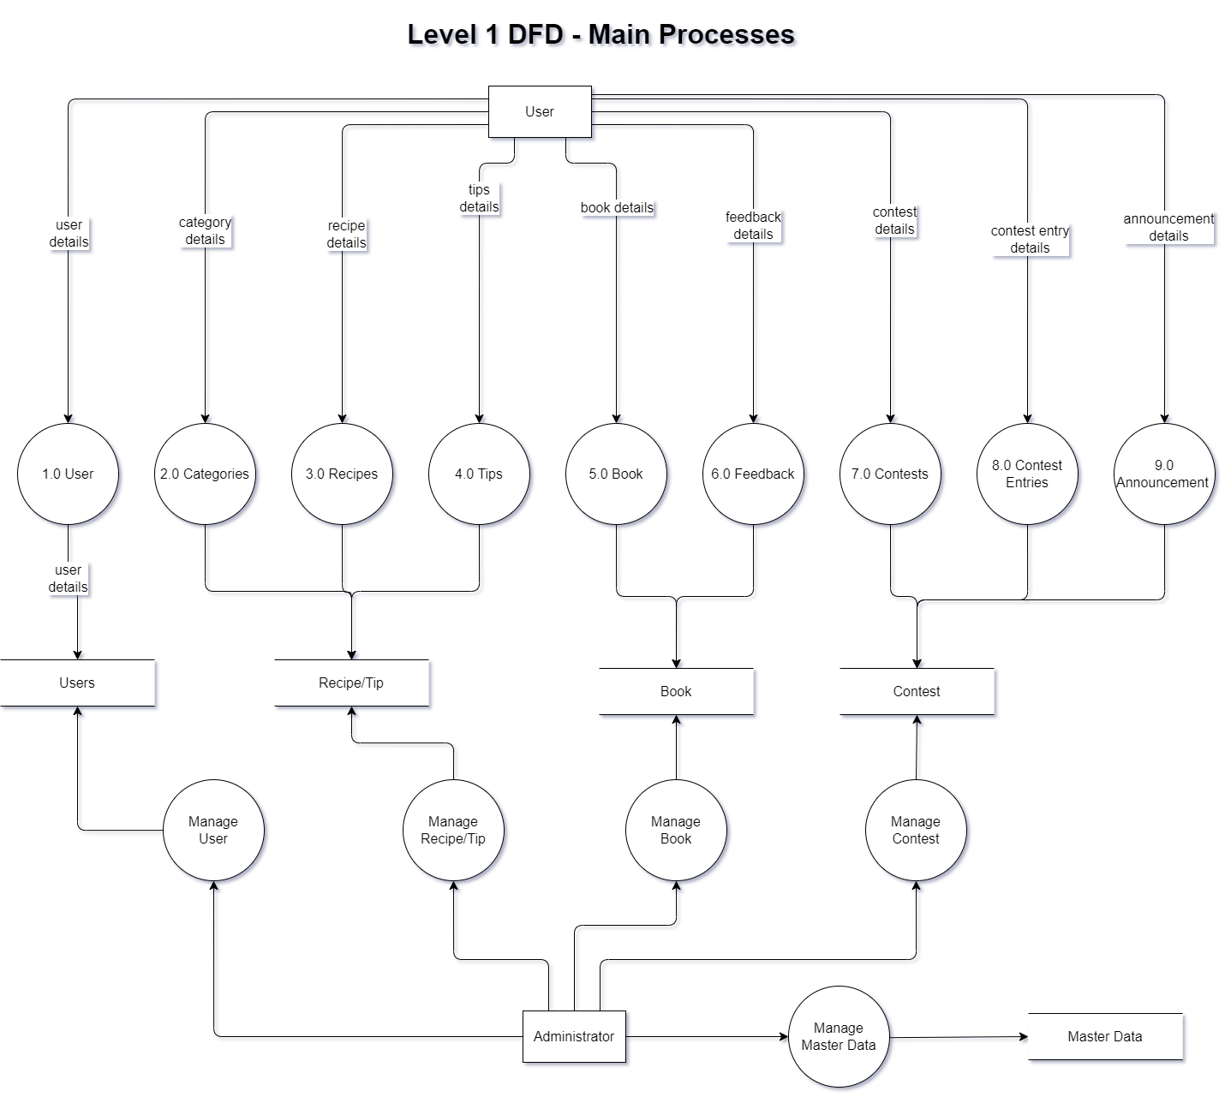
Introduction - Deployment diagram

Slide 6
Test Result [1-n]
Option | Validated
Un-Registered Users can register with provided details after making a payment. | YES
Un-Registered Users are Limited access to various recipes and cooking tips. | YES
Un-Registered Users Are Participate in contests by submitting their own recipes and tips. | YES
Registered Users are Access all functions available to Un-Registered users. | YES
Registered Users Log in and log out of the website | YES
Registered Users Access to all exclusive recipes and cooking tips | YES
Registered Users can change their password, view and edit payment details, view contest participation and feedback history. | YES
Is exception handling mechanism implemented in all the screens? | YES
Are all the program codes working? | YES
Admins can Log in, log out, change password. | YES
Admins can Manage, upload, and categorize recipes and cooking tips | YES
Admins can View and manage contest entries. | YES
Admins can View, change password, and delete user accounts. | YES
Admins can View and delete user feedback. | YES
Admins can Manage categories and recipe classifications. | YES

Slide 7
Test Result [2-n]
Option | Validated
Do all numeric variables have a default value of zero? | YES
Does the administrator have all the rights to create and delete the records? | YES
Are all the records properly fed into the appropriate database? | YES
Have all the modules been properly integrated and are completely functional? | YES
Have all the Design and Coding Standards been followed and implemented? | YES
Is the GUI design consistent all over? | YES
Is the navigation sequence correct through all the forms/screens in the application? | YES
Is exception handling mechanism implemented in all the screens? | YES
Are all the program codes working? | YES
User-friendly User Interface (UI) and User Experience (UX) | YES
Clean, maintainable, and scalable code. | YES
Enhanced performance of the website. | YES
Compatibility with all modern browsers. | YES
Responsive design for mobile, tablet, and desktop devices. | YES
Minimize bugs and errors on the website. | YES

Slide 8
Conclusion
Sr. No. | Particulars | Yes | No | NA | Comments
1 | Are all users able to search for a particular record? | Yes
2 | Are all old records properly saved and retrieved when required? | Yes
3 | Have all modules been properly integrated and are completely functional? | Yes
4 | Are GUI contents devoid of spelling mistakes? | Yes
5 | Is the application user-friendly? | Yes
6 | Is the project published properly into a setup file? | Yes

Slide 9
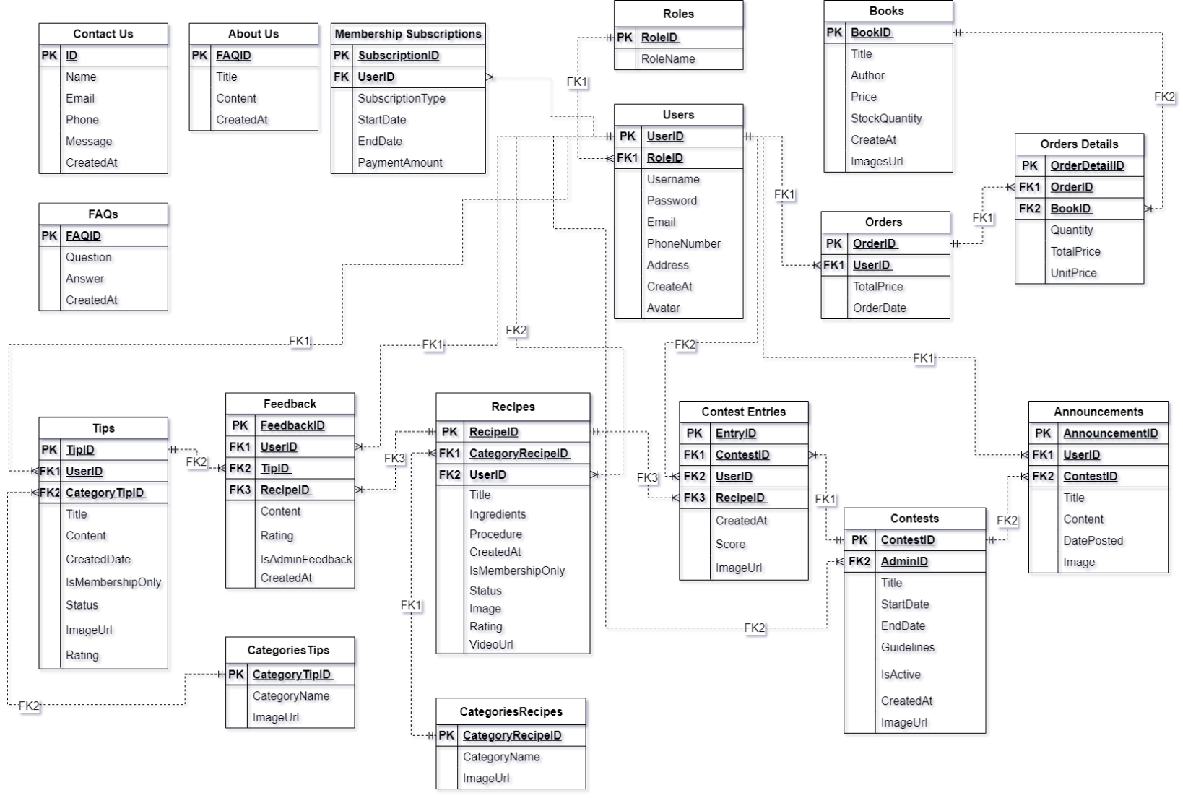
Development

Slide 10
Task List
Project Ref. No.: eP/Advertisement Portal Management System/01 |  | Activity Plan Prepared By: | Date of Preparation of Activity Plan:
St.No. | Task |  | Actual Start Date | Actual Days | Team Mate Names | Status
1 | Contest Entries Page Backend & Front End Announcement Page Backend & Front End Anonymous Recipes Anonymous & Users Contest Entries | Bui Tran Anh Tri | 29/12/2023 | 11 | Bui Tran Anh Tri | Completed
2 | Book Page Backend & Front End Contact Us/ About Us Design Front End |  | 29/12/2023 | 11 | Nguyen Hoang Trung | Completed
3 | Homepage Categories Recipes & Tips Recipes & Tips Page Recipes & Tips: Index/Search/Filter/Sort/ Create/Update/Delete Embedded Youtube Link to Recipes Page
3 | Homepage Categories Recipes & Tips Recipes & Tips Page Recipes & Tips: Index/Search/Filter/Sort/ Create/Update/Delete |  | 29/12/2023 | 11 | Pham Tien Duc | Completed
4 | User/Login/Role Membership Subscription FAQs Page Embedded Paypal to Payment Page |  | 29/12/2023 | 11 | Hoang Ngoc Phu | Completed

Slide 11

Thank You

Slide 12
Reference
https://learn.microsoft.com/en-us/aspnet/core/fundamentals/target-aspnetcore?view=aspnetcore-8.0&tabs=visual-studio
https://learn.microsoft.com/en-us/aspnet/core/?view=aspnetcore-8.0
https://my-learning.w3schools.com/
Refer to following link for ASP.NET MVC best practices: https://blogs.msdn.microsoft.com/aspnetue/2010/09/17/best-practices-for-asp-net-mvc/ Other References: https://azure.microsoft.com/en-in/campaigns/developer-guide/ https://azure.microsoft.com/en-in/services/sql-database/ https://docs.microsoft.com/en-us/azure/virtual-machines/windows/ https://docs.microsoft.com/en-us/azure/app-service/

